Slide 1
Foundation Of Computer Science
Eng: Mohamed Agami

Slide 2

Objective
Hardware
Software
Network
Operating system
Mobile device
Virtualization and Cloud computing

Slide 3

Lecture 1

Slide 4
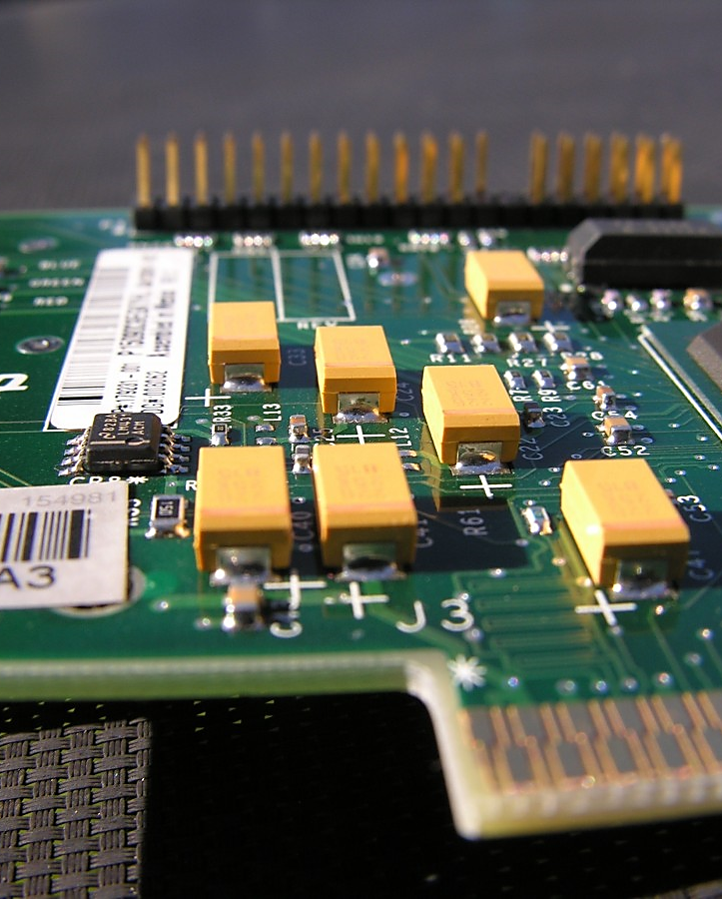
Introduction To Hardware

Slide 5



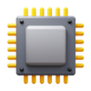
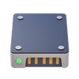
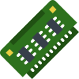
What are the components of a computer?
Software
The programs that control the computer and perform tasks.
Hardware
The physical components of a computer, like the processor, memory, and storage.

Slide 6



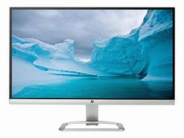
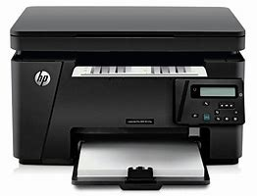




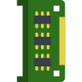
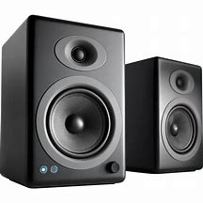
Types of hardware
Processing And Storage
Input device
Output device
Storage
Keyboard
Mouse
Monitor
Printer
Permanent | Temporary
processor
Hard disk
RAM
Camara
Microphone
Speakers

Slide 7
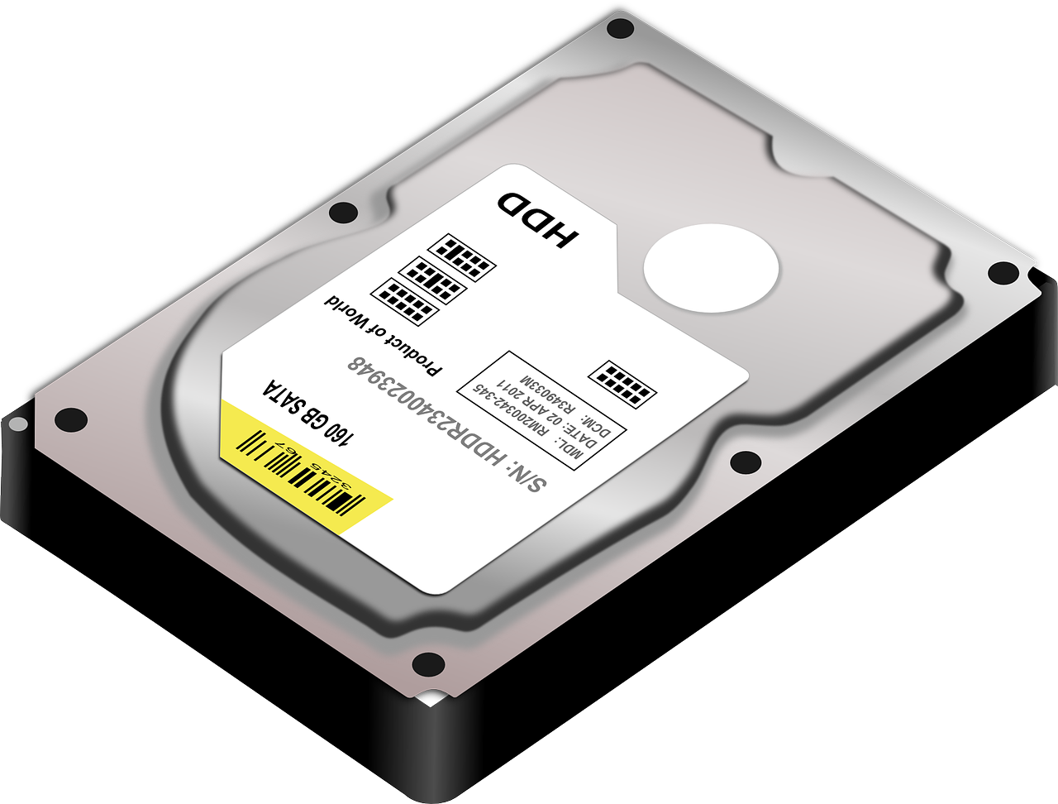
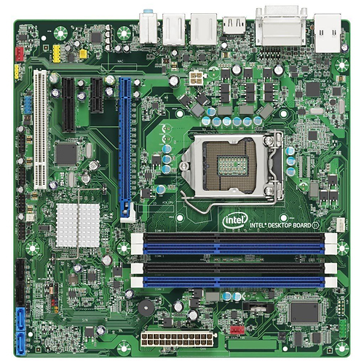
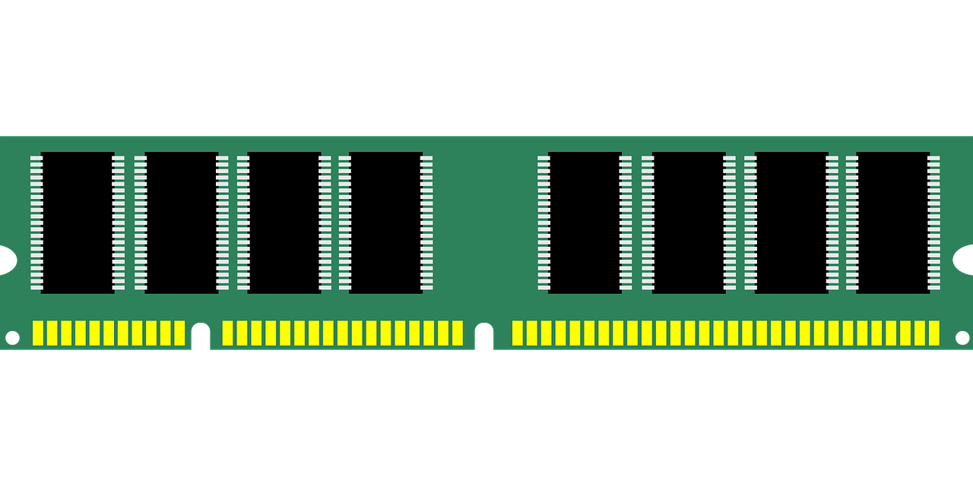
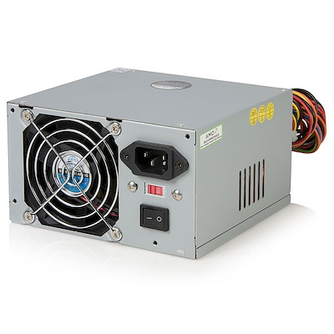
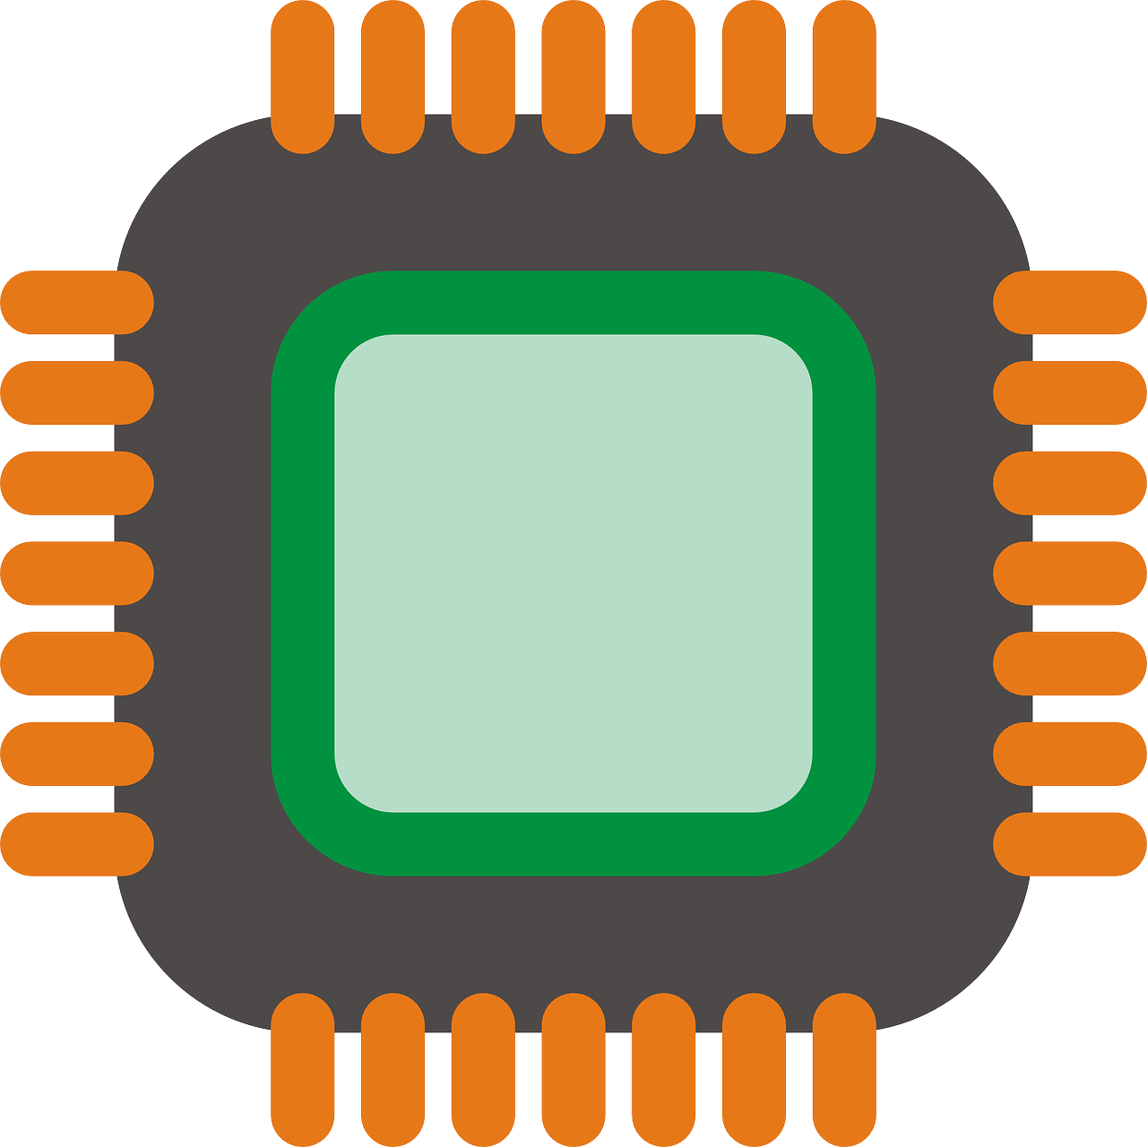
power supply

Slide 8
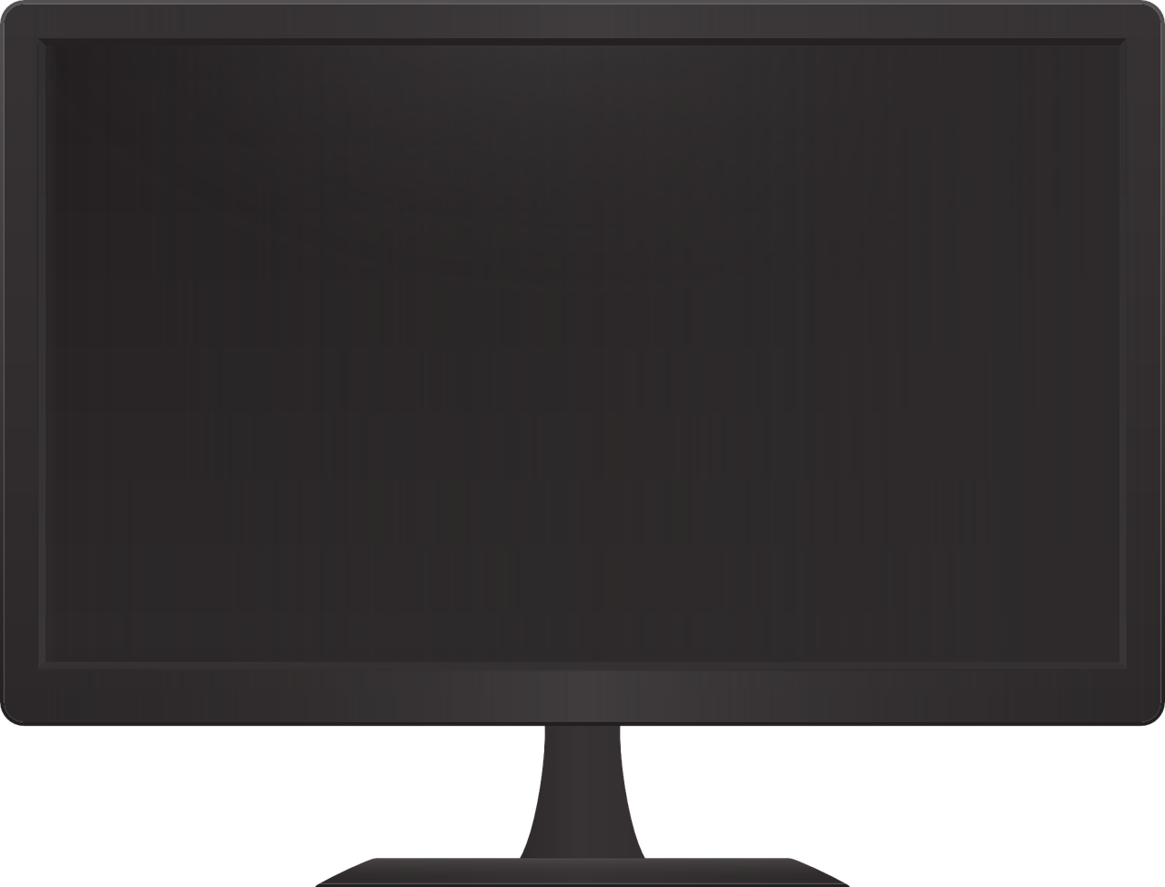
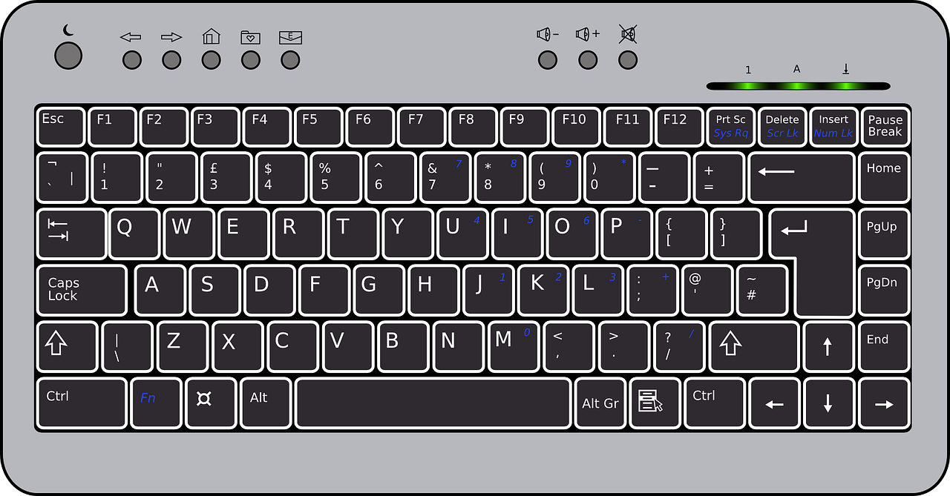
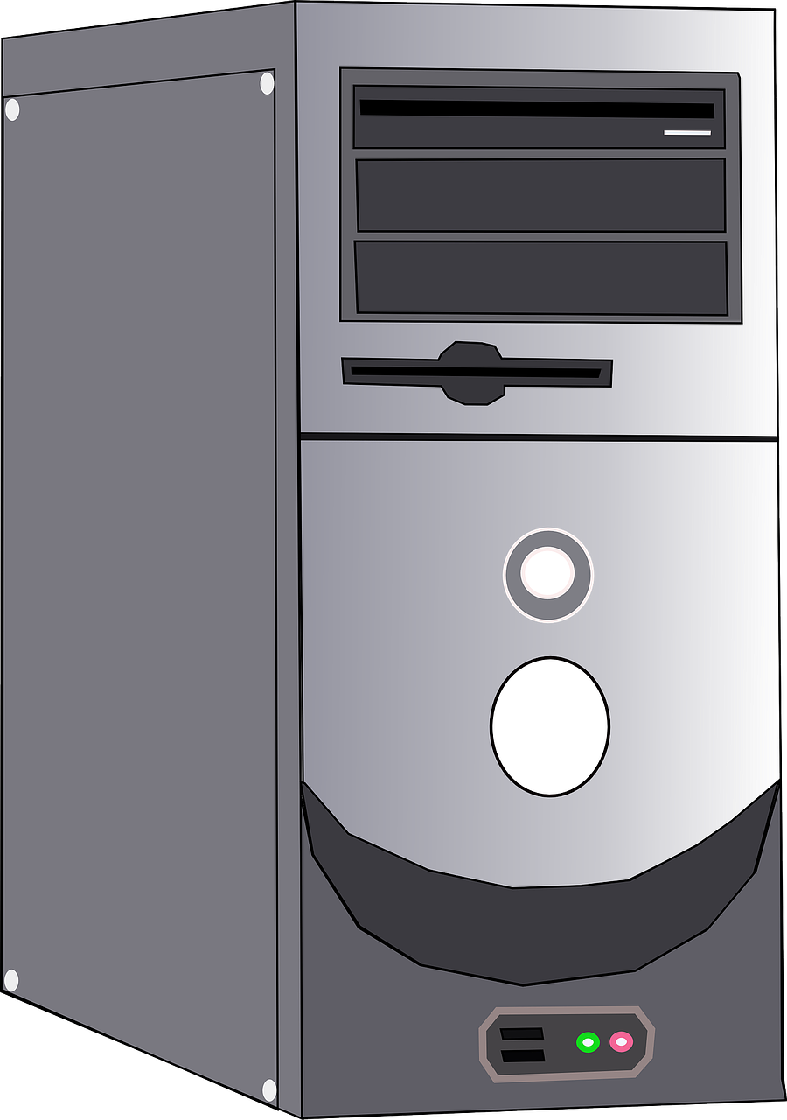


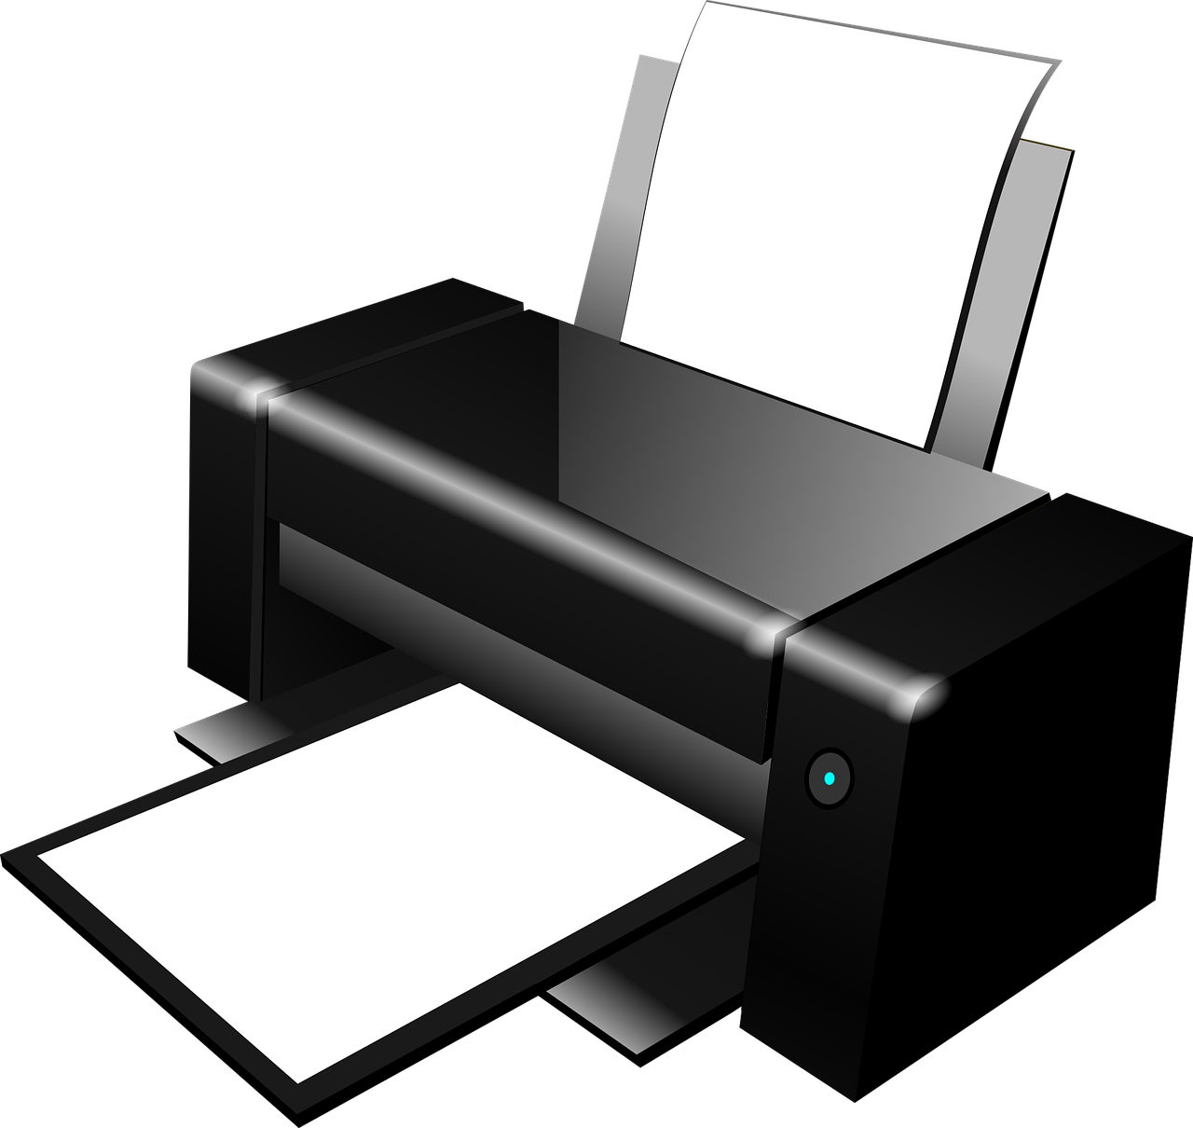
Peripherals

Slide 9
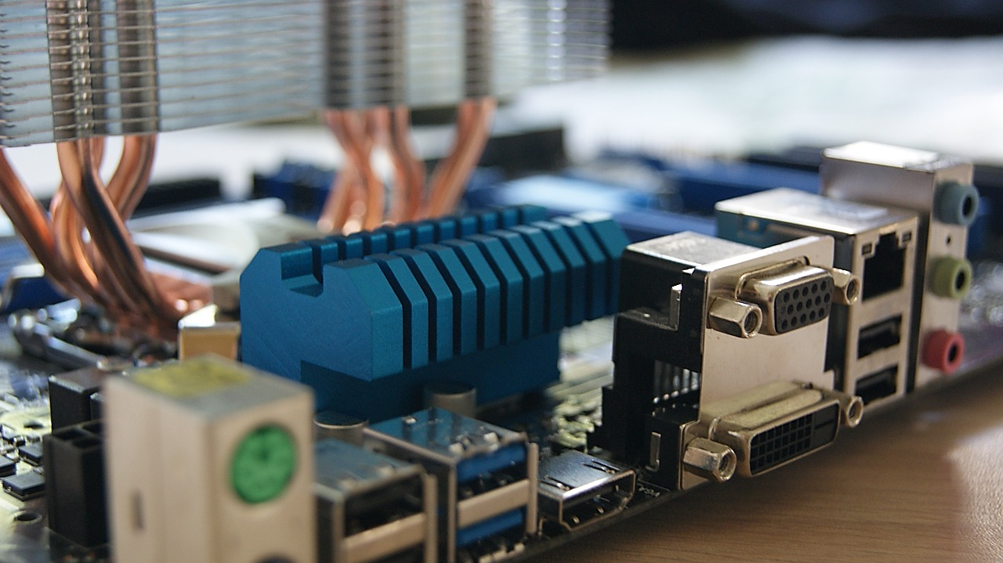
1/0 ports

Slide 10
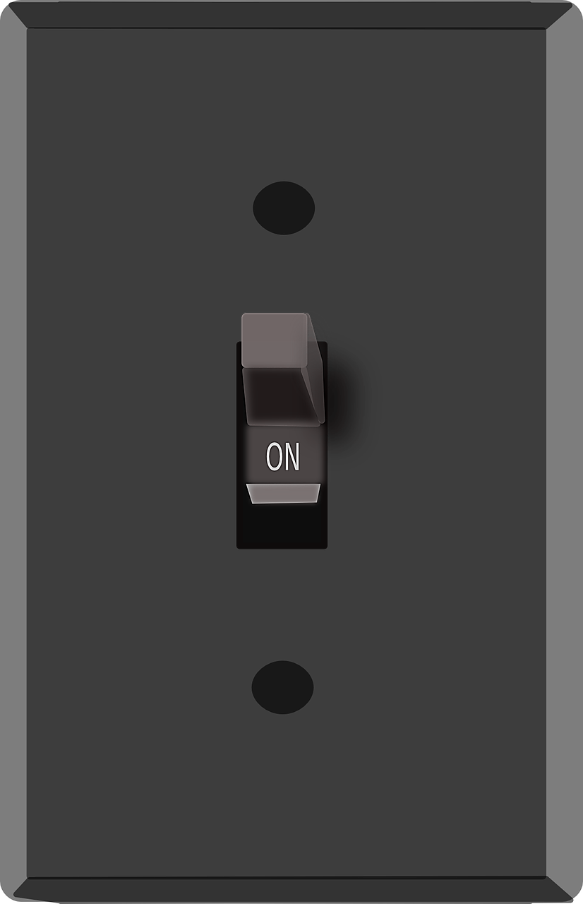
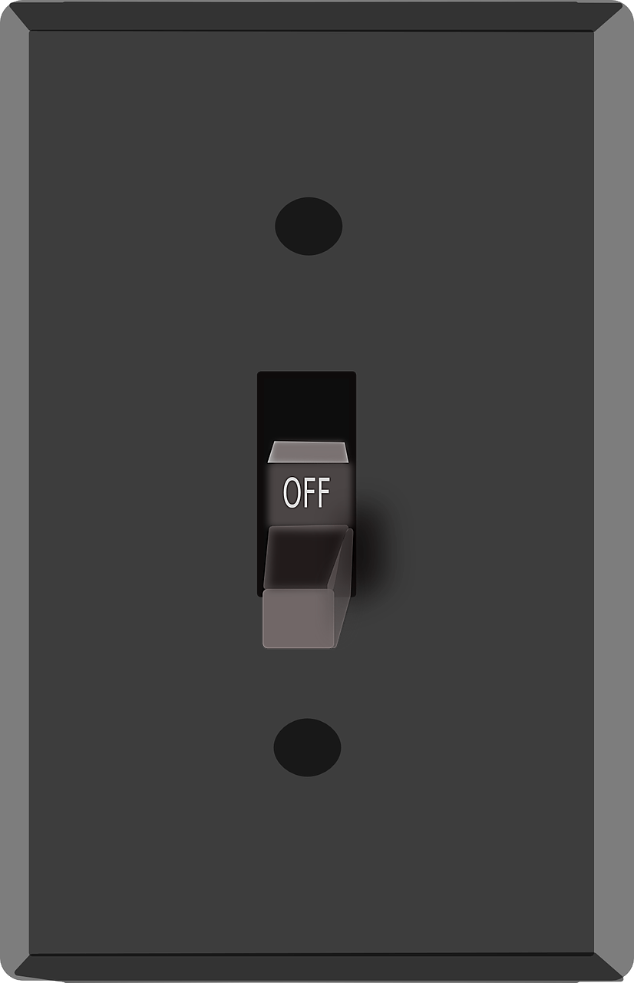


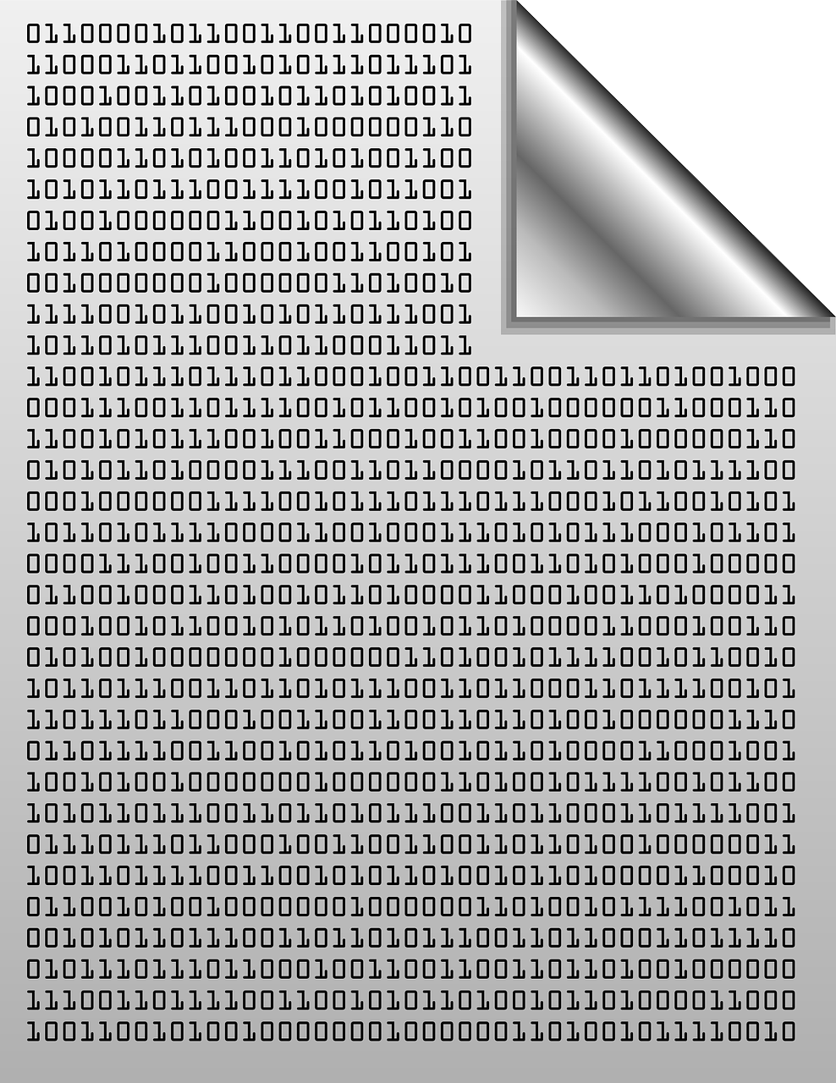
Binary system

Slide 11
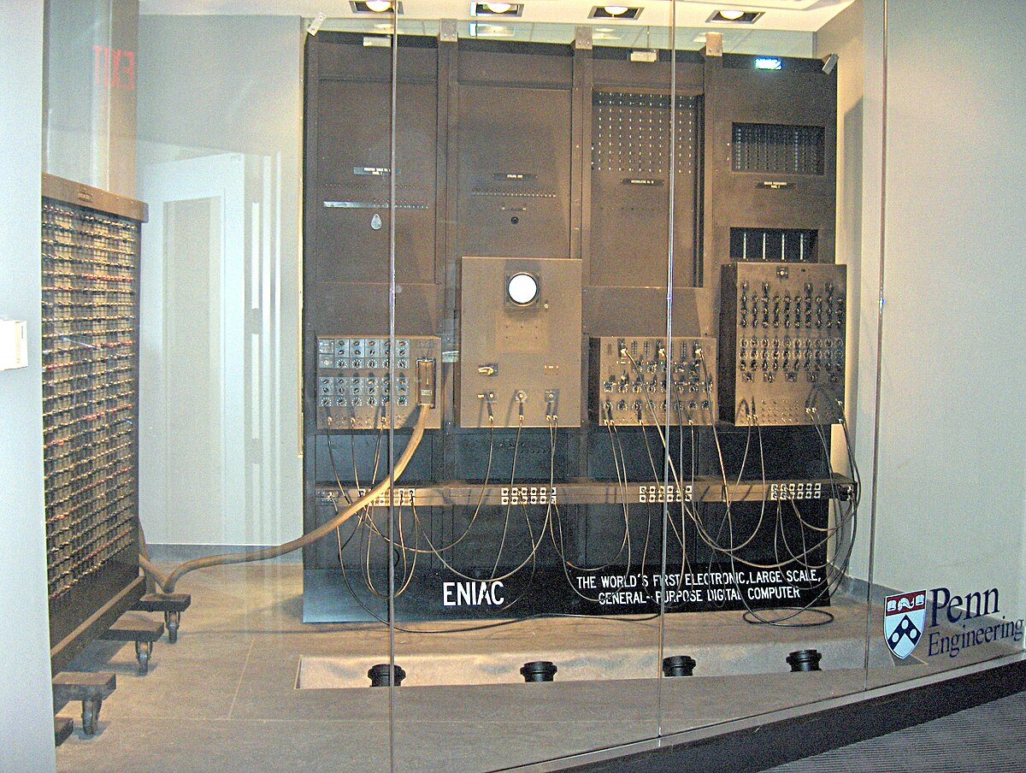
IN 1946
The ENIAC (Electronic Numerical Integrator and Computer) system is the foundation on which the first electronic digital computer was built in 1945. ENIAC relied on vacuum tube technology, which was used to form electronic circuits and perform calculations

Slide 12
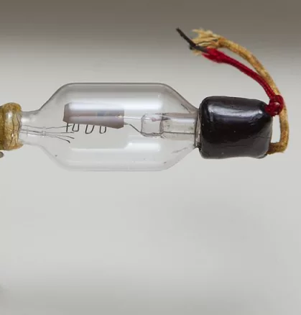
vacuum tube
A vacuum tube, also known as a thermionic valve, is an electronic device used to control the flow of electrical current in a vacuum-sealed environment. It consists of several electrodes (such as a cathode and an anode) enclosed in a glass or metal container that is evacuated of air or gas. Vacuum tubes were widely used in early electronic devices, such as radios, televisions, and early computers.
EUIAC = 17,468
It was up to 5,000 calculations per second

Slide 13
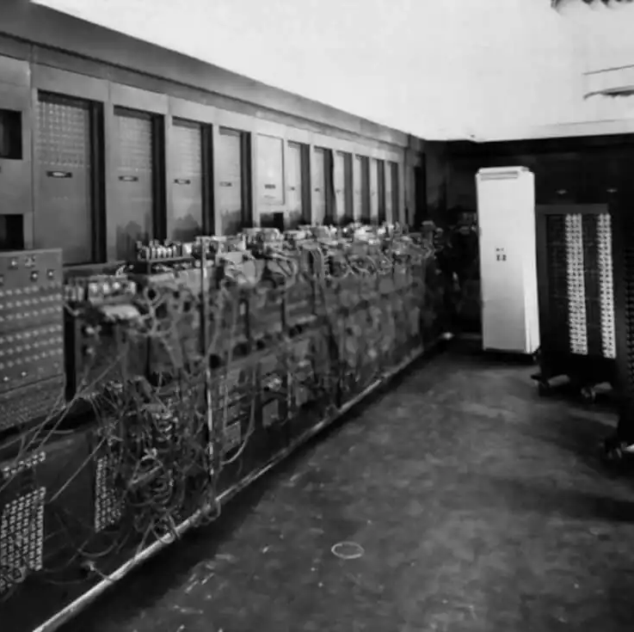
First generation (1950s) - vacuum tube computers
Specifications: Vacuum tubes continued to be used, and these devices were large, expensive, and consumed a lot of energy.
Examples: UNIVAC I (1951), used by the US government for statistics.
Programming: Programming relies on manually entered commands using punch cards or magnetic strips.

Slide 14
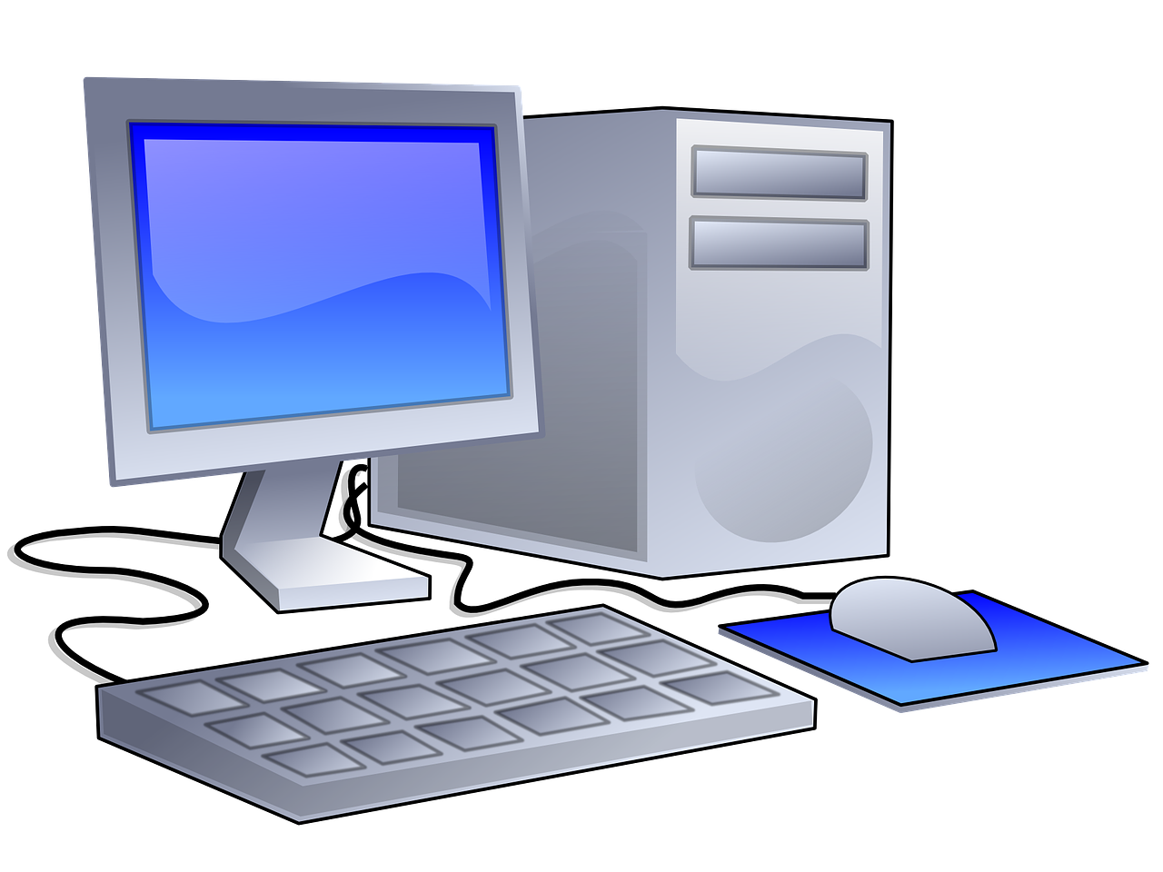
1010010111001001001010
0 & 1 => bit
00000110 => byte

Slide 15
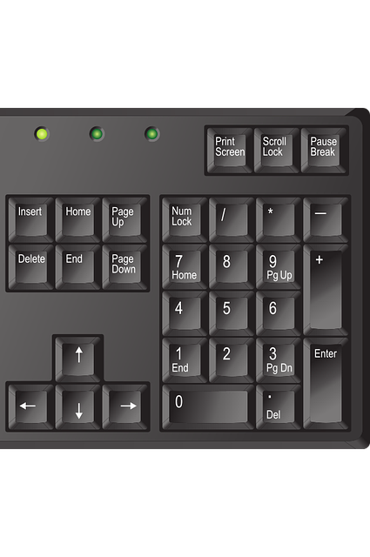

00000110

Slide 16
PC Hardware Components
For a computer to function, it needs a central processing
unit (CPU) for communications
programs to execute
and electricity

Slide 17
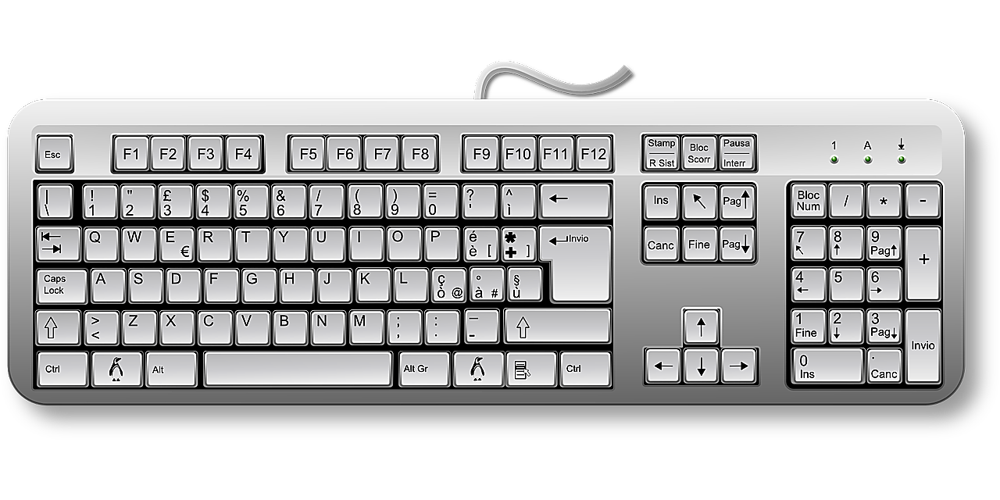
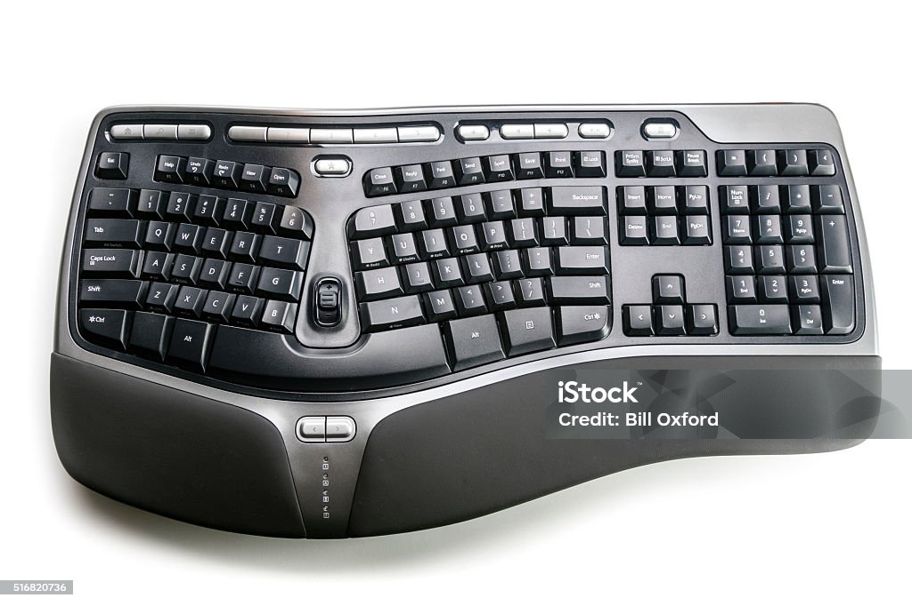
Hardware used for input and output
Ergonomic keyboard
104 Keys

Slide 18
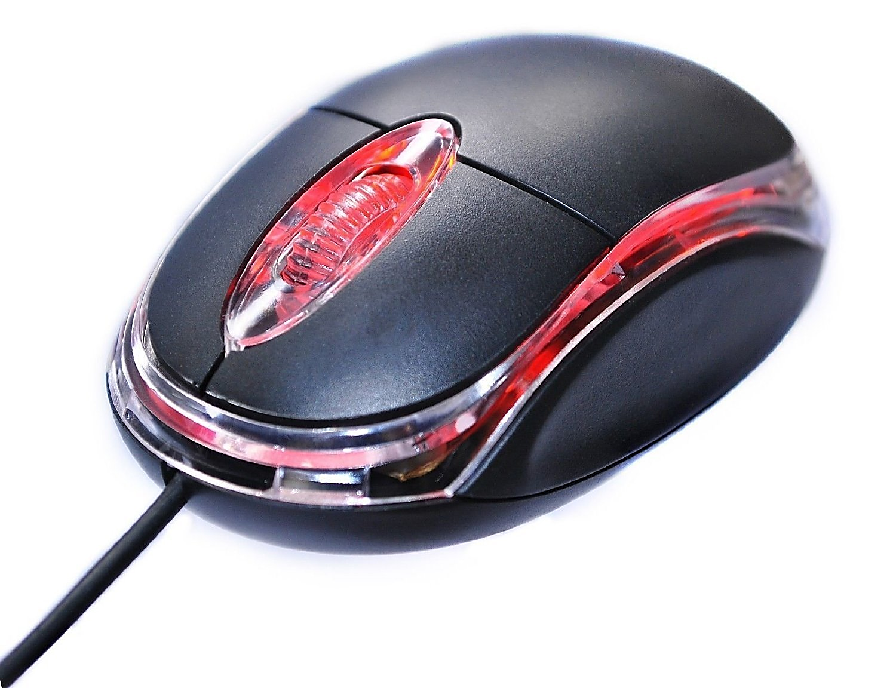
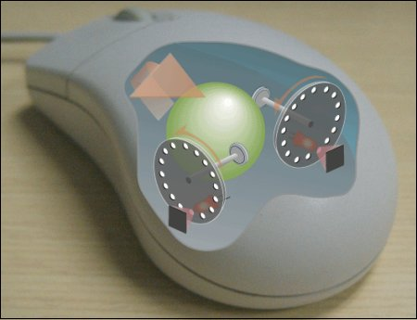
Hardware used for input and output
Machinal mouse
Optical mouse

Slide 19
Hardware used for input and output
I love challenges and new experiences
Mohamed agami
I love challenges and new experiences
Mohamed agami
Monitor (screen)
Printer
Soft copy
hard copy

Slide 20
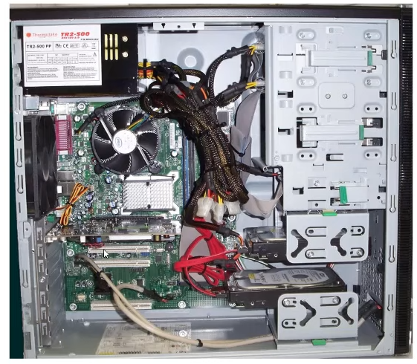
Hardware inside the computer case
Motherboard
RAM
CPU
Hard disk

Slide 21
Storage device
Primary storage device: Fast, temporary storage for immediate data access (e.g., RAM).
Secondary storage device: Long-term storage for data retention (e.g., HDD, SSD).

Slide 22
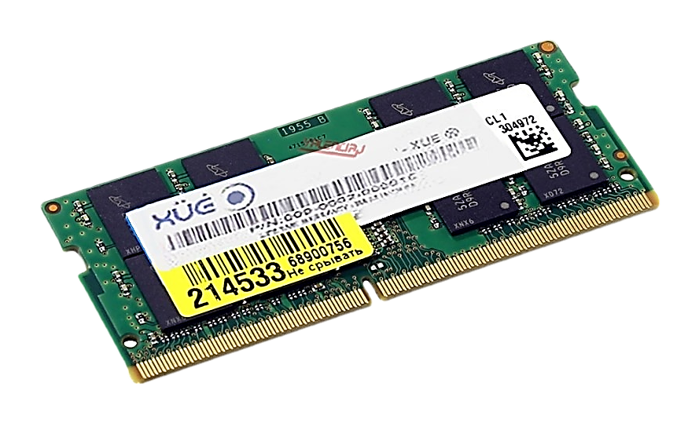
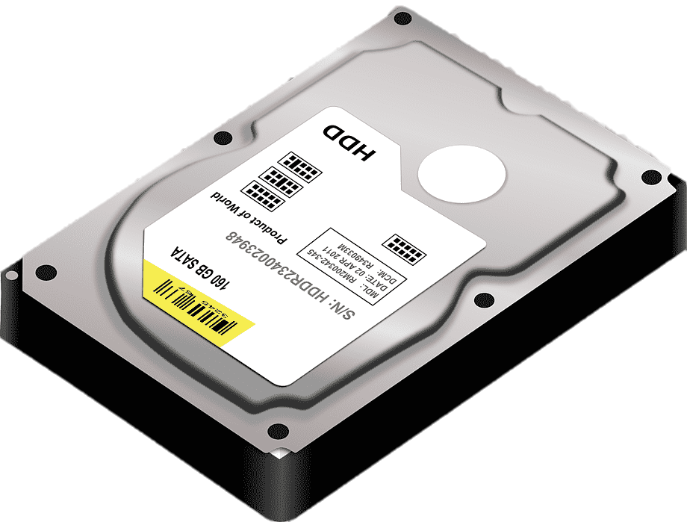
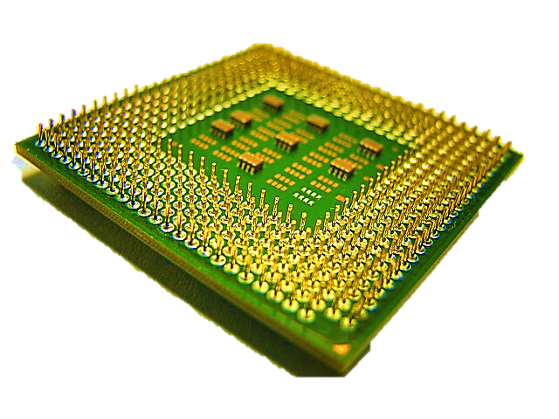



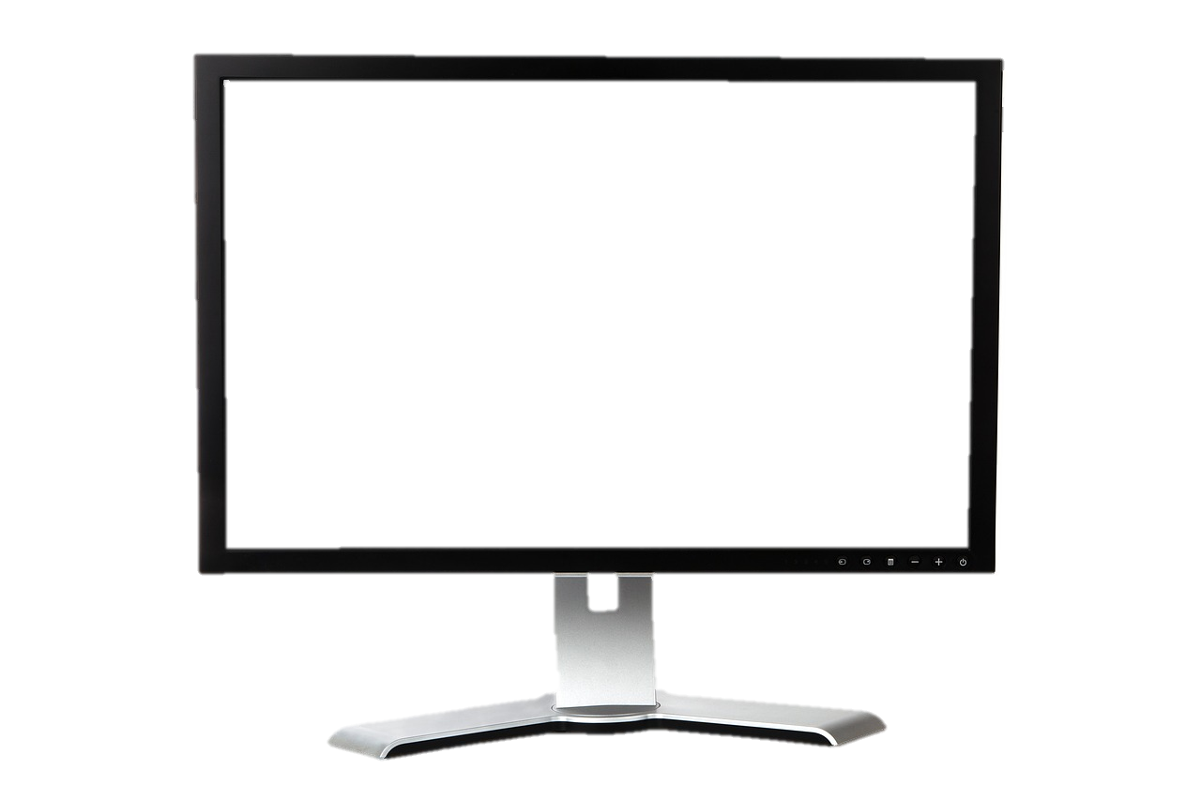

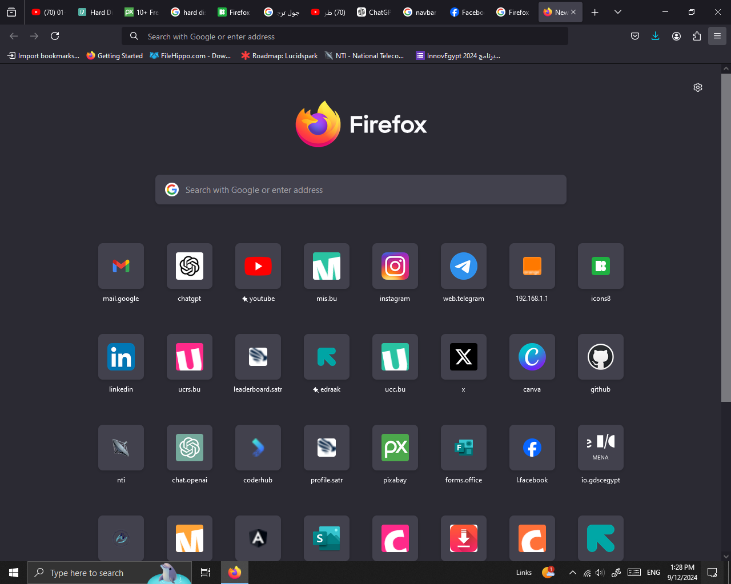

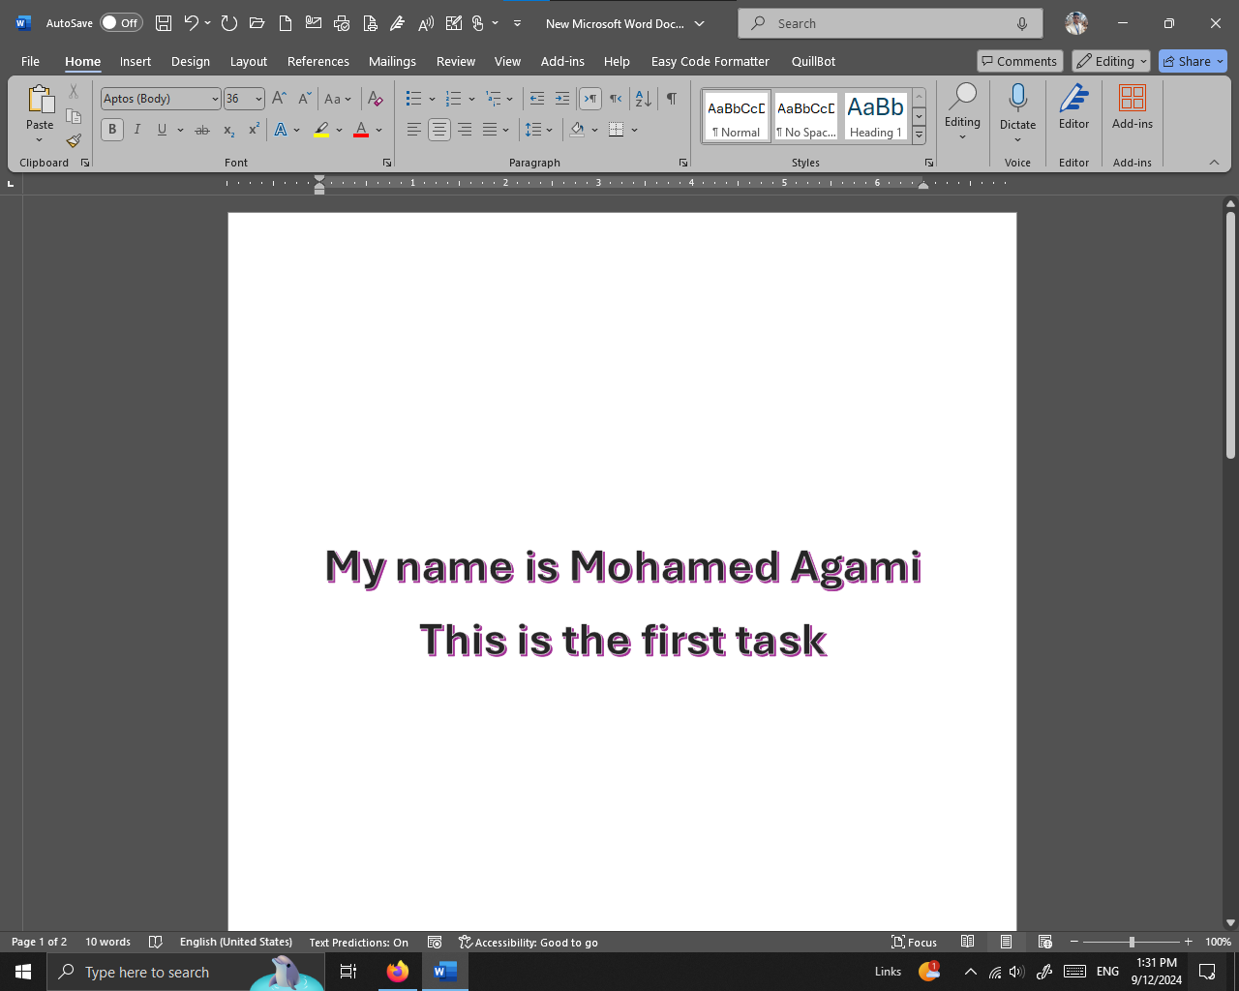

Slide 23
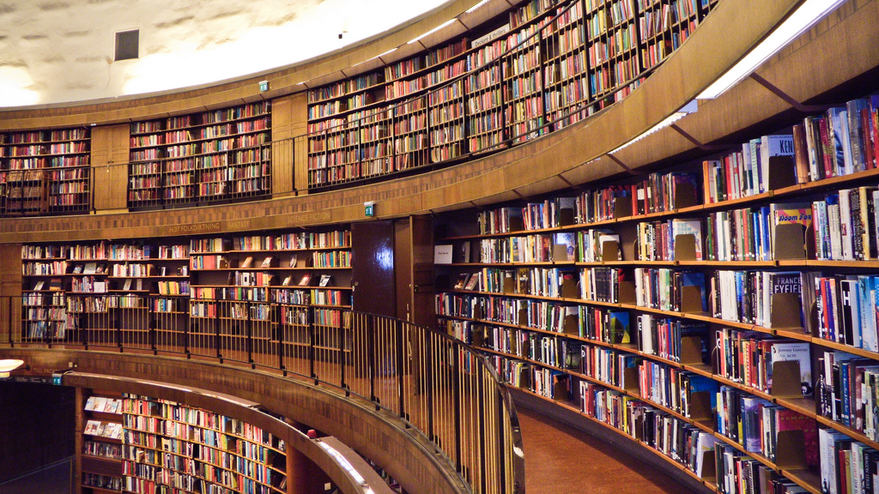

Slide 24


